Slide 1


Olujide Jacobs
Caleb Azonsi
Edwin Mann
2nd of December 2015

Slide 2
Overview
•The mercury robot challenge
Competition will be held in Oklahoma state university
Absence of the operator(at least 50 miles from robot).
Robot must be able to navigate and perform certain arm functions

Slide 3
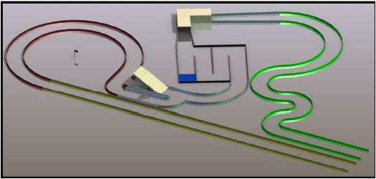
Course

Slide 4
•The track in which this robot will travel through will be 24 inches wide and will be surrounded foam walls about 3 inches tall.
•Obstacles: Serpentine road, a 90º tunnel, a bean bag, U-turn zones, a see-saw with no guards, a delivery point for the bean bag, and a 45 feet long straight road.
•Obstacles determine the robot efficiency and durability.

Slide 5

Rules
•15 minutes to operate the robot. 5 minutes for setup and 10 minutes to complete the course no more than 3 times
•Contact with wall, bean bag drop reduce points.
•The closer the bean bag is to the flag, the more points awarded
•The operator is only allowed to communicate with the robot, not members.

Slide 6
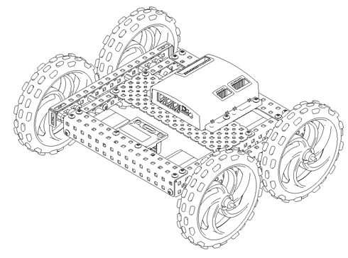
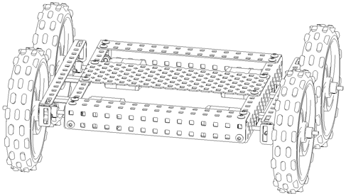
Design

Slide 7
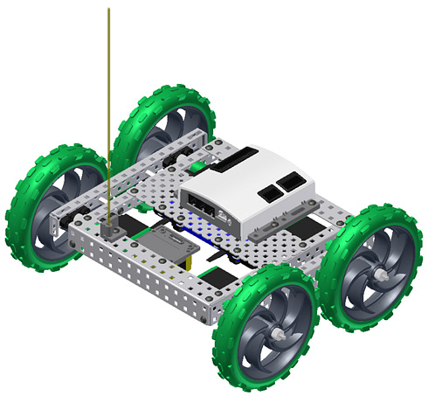
Design

Slide 8
Features
4 wheel Drive
Clincher / Pincher Arm
4 sensors preventing accidents
Power battery
Control Receiver
Static IP Camera

Slide 9
Real World Relevance
This robot is very useful for long distance explorations like rescue missions and extra-terrestrial explorations.
For instance, miners rescue.

Slide 10
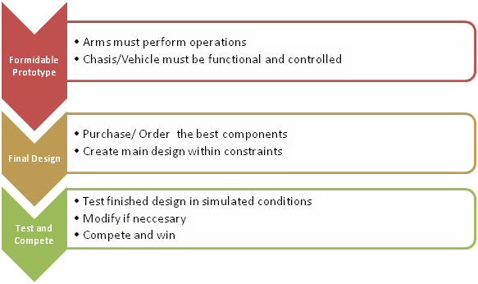
Project Plan/Goals

Slide 11
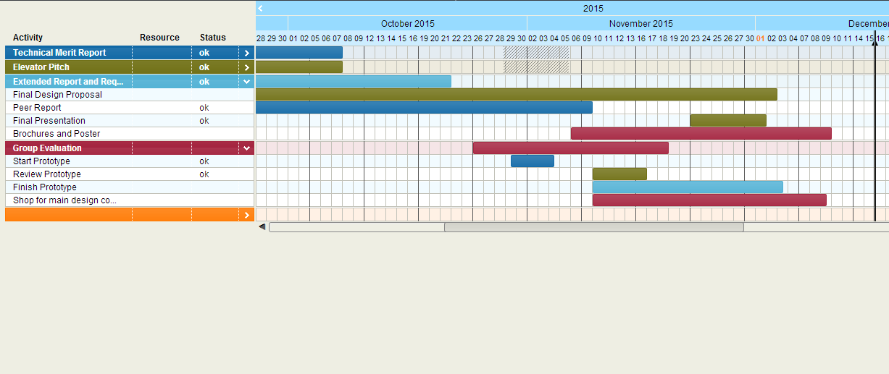
GANTT CHART

Slide 12



